Slide 1
Helping Schools Educate Students with Acquired Brain Injury
A presentation to the
Hospital Educators and Academic Liaisons Conference
May 1, 2023
By Gayle Domsch, EdD

Slide 2
Objectives
To gain new knowledge about making school recommendations
To learn long term consequences of ABI/TBI to patients, parents, and schools
To influence school perceptions about working with students who have experienced traumatic or other acquired brain injury
To communicate instructional techniques for patients with traumatic or other acquired brain injury.

Slide 3
Questions Teachers Ask about Brain Injury
Can’t a brain injury be fixed?
Can a public school handle a student with brain injuries?
How can teachers assess after a brain injury?
Can they learn?
How do you know if the brain injury causes the problem?
Will some days be better than others?
Once they remember, aren’t they okay?
I don’t see anything wrong, so why does he/she need extra support?

Slide 4
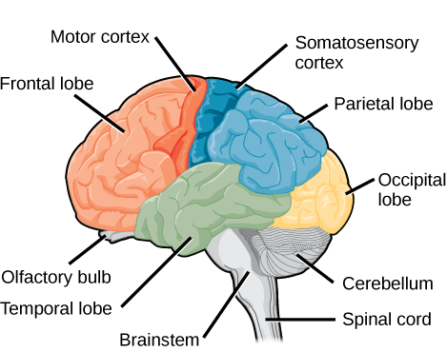
Characteristics of Acquired Brain Injury (ABI)
Includes TBI as the largest group
Not hereditary, congenital, degenerative or induced by birth trauma (is any brain injury post-birth)
Injury results in a change to the brain’s neuronal activity
Range of mild, moderate, or severe impairments
Focal, multi-focal, or diffuse
Range of population groups

Slide 5
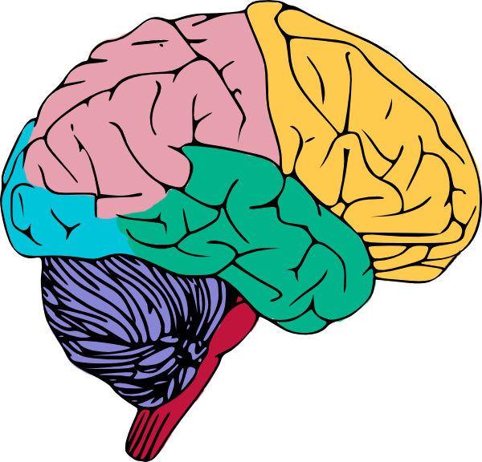
Acquired Brain Injury
Non-Traumatic
Traumatic
Internal disease process that leads to damaged brain tissue
External traumatic event in which injury to the brain is sustained

Slide 6
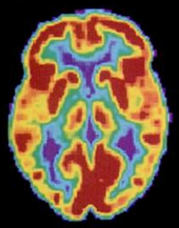
Acquired Brain Injury
Non-Traumatic
Internal disease process that leads to damaged brain tissue
Strokes
Ischemic
Hemorrhagic
Infections
Meningitis
Encephalitis
Anoxia
Near drowning
Heart attack
Tumors
Drug or alcohol consumption

Slide 7
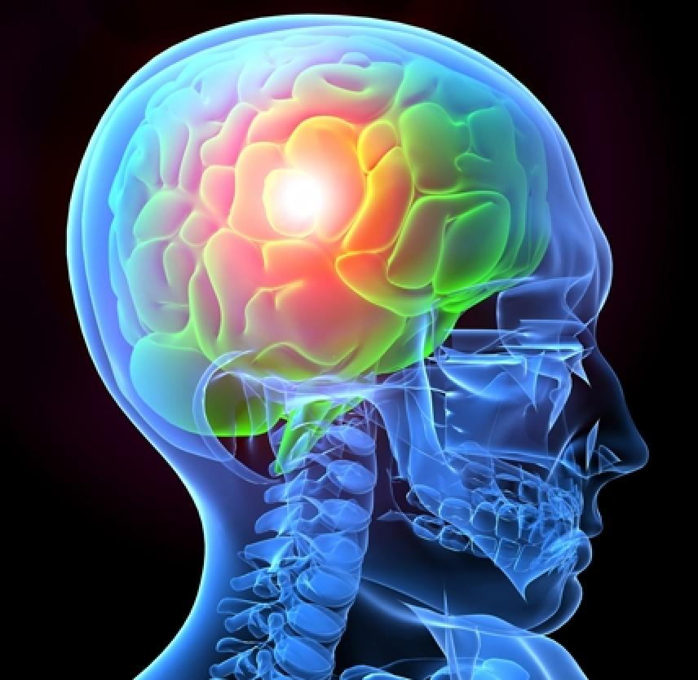
Acquired Brain Injury
Traumatic
Largest subgroup of ABI
External traumatic event in which injury to the brain is sustained
Falls
Motor vehicle accidents
Sport injuries
Assaults
Caused by the impact of an external physical force to the head OR inertial forces
Open or closed head injury

Slide 8
Incidence of ABI/TBI
Head injuries are one of the leading causes of death and disability in children between 1 and 18 years of age.
Each year, pediatric TBI results in over 500,000 emergency department visits and about 60,000 hospitalizations in the United States.
Head trauma-related deaths exceed 3,000 per year in the pediatric population.
Nearly 90% of patients are discharged from the emergency department after their head injury without hospitalization.

Slide 9
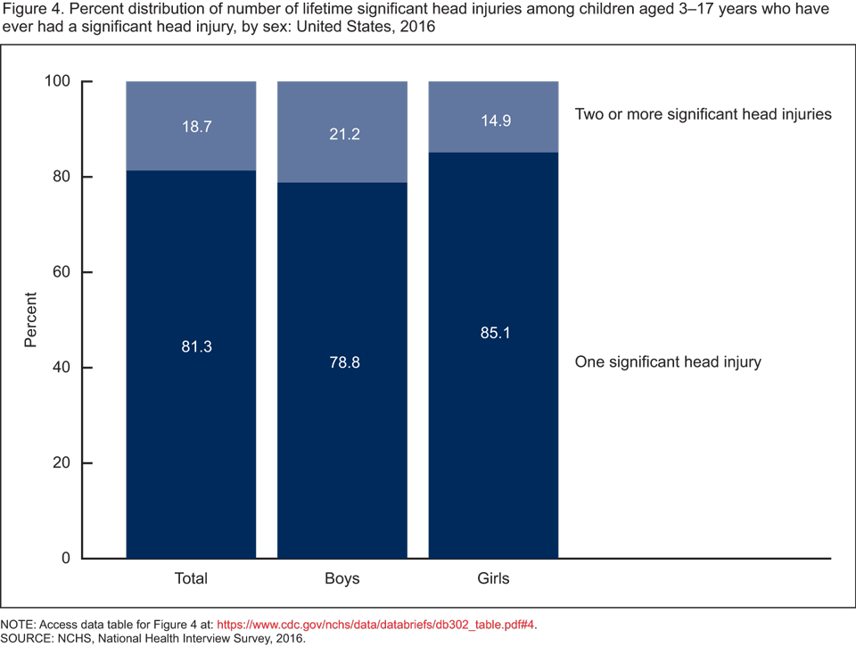
Prevalence of ABI/TBI
According to the National Center for Health Statistics: The percent distribution of number of lifetime significant head injuries among children ages 3-17 who have ever had a significant head injury by sex in the United States in 2016.
Approximately 80% are classified as mild head injuries or concussions.
3% are fatal

Slide 10
Results of ABI/TBI
Resulting brain injury adversely affects the physical integrity, metabolic activity, and/or functional ability of the nerve cells in the brain.
Primary brain damage complicated by secondary neuronal tissue damage from the brain’s response
Range of cognitive, psycho-social and physical deficits
Impairment lasts from a few days to a lifetime
Related complications are frequent
Problems often can worsen over time

Slide 11
Major Recovery Determining Factors
Location of trauma
Severity of injury
Length of coma

Slide 12
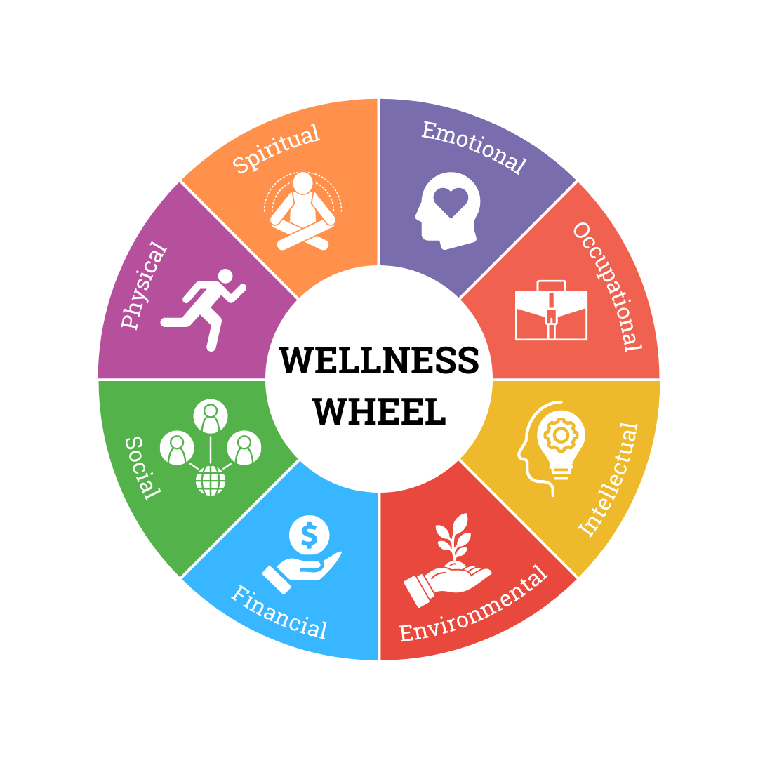
Treatment of ABI/TBI
Rehabilitation and treatment in the same facilities regardless of type of injury
Need for personalized and specific treatment
Need for supported re-integration into the community
Need for comprehensive therapeutic approaches and combined therapies
Need for long-term recovery strategy

Slide 13
School Contacts from Medical Team
Direct communication between school and medical team
Effects of ABI
Initial school re-entry plan
Initial training for educators
CDC (2018): The more educators know about TBI, the better they will be able to support students with TBI in school.
On-going communication for health care plan
ABI history in school record
On-going training for educators
On-going support for parents
Ylvisaker (2001): The medical team has the responsibility for best care for their patients with TBI by providing information for training for teachers and support staff, training for school administrators, and giving continuing on-going support for parents.

Slide 14
Communication with Schools
Advance communication and coordination
Careful assessment including medical, physical, cognitive, and social-emotional needs
Identification of functional needs
Instructional interventions for unique individuals

Slide 15
Making School Recommendations
Positive changes initially
Full impact may not be evident for 12 to 18 months
Improvements can occur for months or years
Often re-learning is needed for some foundational skills
Negative changes as demands increase
Social and emotional difficulties can develop years later
Usually new learning is significantly impaired
Inconsistent patterns of performance
Parents may be unprepared for long-term consequences
On-going assessments needed due to frequent changes

Slide 16
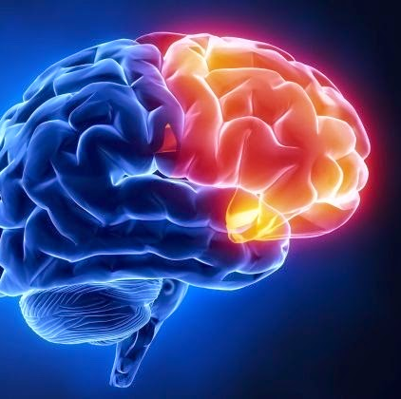
Frontal Lobe Injuries
Greater difficulty with executive function:
Attention
Self-regulation
Goal setting
Initiating tasks
Inhibiting behavior

Slide 17
Long Term Consequences of ABI/TBI
Memory, Learning, and Cognition
Behavior, Social Skills, and Emotional Regulation
Initiation, Inattention, and Impulsivity
Speech and Language
Physical and Sensory Effects

Slide 18
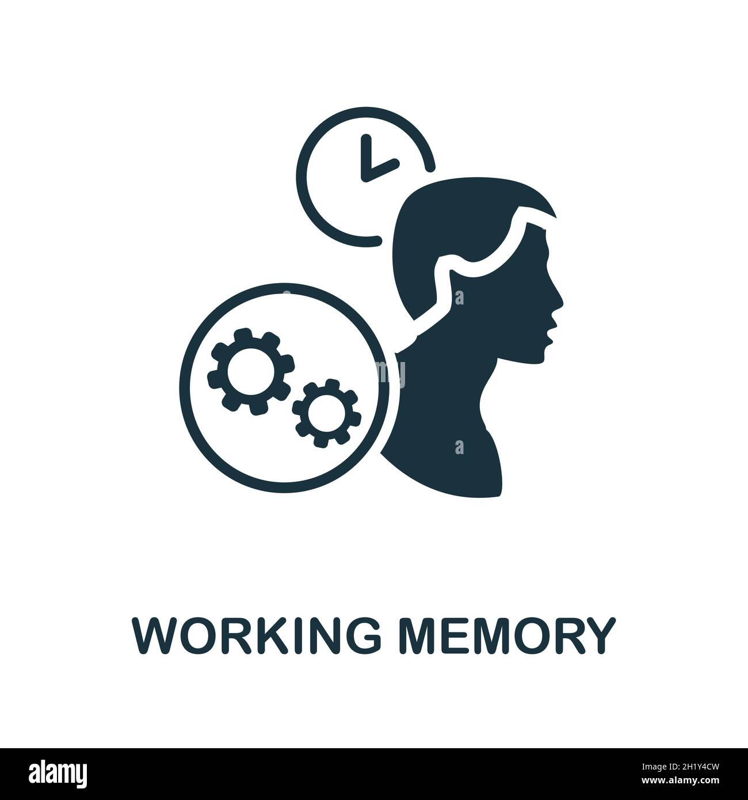
Possible Memory Deficits from ABI/TBI
Difficulty recalling information
Difficulty retaining information
Difficulty learning new information
Forgetfulness
Mental fatigue
Confusion
Knowledge gaps
Dizziness or recurring headaches

Slide 19
Interventions for Memory
Mnemonics
Music
Errorless learning
Simplified directions
Precision commands
Repeating instructions
Chunking information
Shorter sessions
Additional time to relearn concepts and regain skills
Following predictable and consistent routines
Connect to prior learning
Meta-cognitive strategies
Preview tasks

Slide 20
Possible Social Skill Deficits from ABI/TBI
Inappropriate emotional outbursts
Poor interpersonal and communication skills
Emotional lability-frustration
Attention seeking behaviors
Gaining sensory relief
Lack of inhibition
Social isolation
Aggression
Depression

Slide 21
Interventions for Social Skills
Facial affect recognition training
Inferring emotions
Positive support
Self-monitoring strategies
Natural consequences
Constructive feedback
Tangible reinforcements

Slide 22
Possible Attention Deficits from ABI/TBI
Deficits in sustained attention
Deficits in initiation of tasks
Difficulty completing tasks
Difficulty with flexibility
Poor working memory
Lack of inhibition
Poor organizational skills
Problems with sequencing
Sensitivity to overstimulation

Slide 23
Interventions for Attention Deficits
Quiet and simplified environment
Clear course structure
Active listening techniques
Rest breaks
Alternatives to group work
Oral exams or adapted formats
Separate room for testing
Preview of test format
Flexible due dates
Recorded lectures
Notetaker

Slide 24
Possible Speech and Language Deficits from ABI/TBI
Rate of speech
Poor articulation
Weak information processing
Difficulty with abstract thinking
Poor problem-solving abilities
Poor communication skills
Lack of judgement
Aphasia

Slide 25
Interventions for Speech and Language
Speech and language therapists must be integral team members.
On-going assessment of needs
Functional communication training
Communication device
Slowed pace of instruction
Therapy in communication skills
Problem solving training

Slide 26
Possible Physical & Sensory Deficits from ABI/TBI
Changes in motor or processing speed
Changes in physical abilities
Loss of function in extremities
Full or partial paralysis
Spasticity
Poor coordination
Difficulty with strength, balance, or endurance
Difficulty with visual motor skills
Changes in sensory abilities
Overstimulated by noise, lack of structure, or unexpected events

Slide 27
Interventions for Physical & Sensory Effects
Increase number of repetitions in therapy and training
Determine mobility preferences
Facilitate sensory stimulation
Set up sensory relief
Support needs
Provide both oral and written directions
Organize by color coding
Extended time for responses

Slide 28
Other Possible Interventions Needed
Monitoring for sleep disturbances
Mental Health or Psychological services
Behavior support
Assistive technology
Family support for caregivers
Employment aptitude and vocational support
Orientation and mobility services

Slide 29
Traumatic Brain Injury category for IEP (PLAN)
The IEP team shall determine that a student is eligible for and in need of special education and/or related services under the category of TBI if there is documentation by a physician of a medically verified traumatic brain injury for the student.

Slide 30
504 accommodations (if an IEP is not needed)
Allot time/quiet area for breaks
Shorten assignments
Extend time to complete work
Use memory aids
Provide notes and/or allow recordings
Recognize inconsistent performance
Permit preferential seating
Provide visual schedule
Repeat visual and auditory instructions
Change time and setting for assessments as needed
Monitor and record signs of fatigue, exhaustion, and changes in behavior

Slide 31
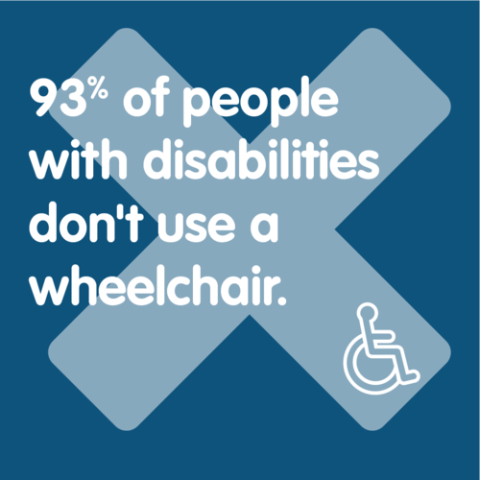
Other Health Impaired IEP category for Non-Traumatic Brain Injury
Having limited strength, vitality, or alertness, including a heightened alertness to environmental stimuli, that results in limited alertness with respect to the educational environment that:
is due to a chronic or acute health problem and
adversely affects a child’s educational performance

Slide 32
On-Going Assessments
Research in longitudinal studies noted children with complicated mild or moderate TBI were more likely to receive school support services and have lower competence ratings at six years post-injury than at two years post-injury
Effects of traumatic brain injury increased over time as students were challenged by either increased demands of academic coursework or social interactions (Prasad, 2017).
Recognize inconsistent academic, social, and behavioral performance

Slide 33
Special Education Services
60,000 children and adolescents sustain moderate to severe brain injuries each year
fewer than 1360 students are identified annually for special education under the TBI category
less than 3% of the potential population is categorized as TBI (Glang, 2004).
30% of students with TBI, initially not referred for special education post injury, were referred for special education services one year later
often mislabeled as Learning Disabled or Other Health Impaired due to the time interval from the injury (Bowen 2021).

Slide 34
Recovery from Acquired Brain Injury: a life-long process

Slide 35
BRAIN INJURY ASSOCIATION OF AMERICA
3057 Nutley Street #805 Fairfax, VA 22031-1931
info@biausa.org
703-761-0750
703-761-0755

Slide 36
Contact information: Gayle D. Domsch, EdD
Hospital Based School Teacher
Children's Mercy Kansas City
2401 Gilham Road Kansas City, MO 64108
Phone: (816) 302-9014
Email: gddomsch@cmh.edu

Slide 37
References
Bowen, J. M. (2005). Classroom Interventions for Students With Traumatic Brain Injuries. Preventing School Failure: Alternative Education for Children and Youth, 49(4), 34–41. https://doi.org/10.3200/psfl.49.4.34-41
Brain, M. (n.d.). T B I Missouri: Traumatic Brain Injury in Missouri. Retrieved March 20, 2024, from http://health.mo.gov/living/healthcondiseases/tbi/pdf/mo-tbi-state-plan-2018-2023.pdf
Dettmer, J., Ettel, D., Glang, A., & McAvoy, K. (2014). Building Statewide Infrastructure for Effective Educational Services for Students With TBI. Journal of Head Trauma Rehabilitation, 29(3), 224–232. https://doi.org/10.1097/htr.0b013e3182a1cd68
‌
Glang, A., Tyler, J., Pearson, S., Todis, B., & Morvant, M. (2004). Improving educational services for students with TBI through statewide consulting teams. NeuroRehabilitation, 19(3), 219–231. https://doi.org/10.3233/nre-2004-19305
Hawley, C. A. (2004). Return to school after brain injury. Archives of Disease in Childhood, 89(2), 136–142. https://doi.org/10.1136/adc.2002.025577
Help Children Return to School after TBI. (n.d.). https://www.cdc.gov/traumaticbraininjury/pdf/reportstocongress/managementoftbiinchildren/factsheets/TBIRTCFS-Schools-508.pdf
Keyser-Marcus, L., Briel, L., Sherron-Targett, P., Yasuda, S., Johnson, S., & Wehman, P. (2002). Enhancing the Schooling of Students with Traumatic Brain Injury. TEACHING Exceptional Children, 34(4), 62–67. https://doi.org/10.1177/004005990203400409
Lash, M. (2004). Children and Youth with Traumatic Brain Injury. NeuroRehabilitation, 19(3), 173–174. https://doi.org/10.3233/nre-2004-19301
Levin, H. S., & Hanten, G. (2005). Executive Functions After Traumatic Brain Injury in Children. Pediatric Neurology, 33(2), 79–93. https://doi.org/10.1016/j.pediatrneurol.2005.02.002

Slide 38
References -continued
Linden, M., & McKinlay, A. (2019). Childhood acquired brain injury affects adult outcomes. Disability and Rehabilitation, 1–2. https://doi.org/10.1080/09638288.2019.1660916
Mazzarella, P., Pahr, C., & Tyler, J. (2017). Helping Families Navigate the School System to Obtain Appropriate Services after Acquired Brain Injury. Brain Injury Professional, 14(3), 15-17. https://www.brainline.org/article/helping-families-navigate-school-system-obtain-appropriate-services-after-brain-injury
Traumatic Brain Injury / Concussion | Concussion | Traumatic Brain Injury | CDC Injury Center. (2023, September 7). www.cdc.gov. https://cdc.gov/traumaticbraininjury
Prasad, M. R., Swank, P. R., & Ewing-Cobbs, L. (2017). Long-Term School Outcomes of Children and Adolescents With Traumatic Brain Injury. Journal of Head Trauma Rehabilitation, 32(1), E24–E32. https://doi.org/10.1097/htr.0000000000000218
Taylor, H. G., Yeates, K. O., Wade, S. L., Drotar, D., Stancin, T., & Montpetite, M. (2003). Long-Term Educational Interventions After Traumatic Brain Injury in Children. Rehabilitation Psychology, 48(4), 227–236. https://doi.org/10.1037/0090-5550.48.4.227
Tyler, J. (n.d.). Executive Skills after Brain Injury in Children and Teens. Retrieved March 20, 2024, from https://www.crisoregon.org/cms/lib/OR01928264/Centricity/Domain/102/Executive_Skills_after_BI_-in_Children_and_Teens.pdf
Returning to School After TBI | BrainLine. (2011, February 10). Www.brainline.org. http://www.brainline.org/article/returning-school-after-tbi
Ylvisaker, M., Todis, B., Glang, A., Urbanczyk, B., Franklin, C., DePompei, R., Feeney, T., Maxwell, N. M., Pearson, S., & Tyler, J. S. (2001). Educating Students with TBI: Themes and Recommendations. Journal of Head Trauma Rehabilitation, 16(1), 76–93. https://doi.org/10.1097/00001199-200102000-00009

