Slide 1
A Better Pathway: Psychiatric Research-Based Practices to Improve School Transition
Presented By:
Ashley Hurse, MA
School Services Manager
&
Talia Fayson-Anthony, M.Ed.
School Services Psychiatry Program Manager

Slide 2
Objectives
Application of Research Based Practices/ Processes
Mental Health Statistics
Evaluation of Effectiveness
Research Based Practices
Questions

Slide 4
Attendees will learn how Children’s School Services developed and updated their psychiatry school services program and processes based on current research.
Attendees will learn how Children’s School Services integrated into new areas of psychiatry.
Attendees will learn how we developed our patient and parent educational history questionnaires and patient transition plans using current research.
Objectives

Slide 5
National Mental Health Statistics
Statistics

Slide 6
According to the CDC 1 in 6 children, ages 6-17, experience a mental health disorder.
According to the state of mental health 2023, “16% of youth suffer from at least one major depressive episode in the past year.”
Of the statistics presented only 28% of the youth receive treatment
Mental Health Statistics

Slide 7
Mental Health Statistics
It is estimated, that in the US and Canada, one-third of students are re-hospitalized in a year without proper support after discharging from mental health treatment facility. This includes school transition support
According to the article “Associated With Child and Youth Mental Health Readmissions from a US National Database”:
Even though it is true that relapses happen and leads to hospital readmission, rates of 30-day readmissions for youth have been found to be as high as 10% to 14%.
Mental Health Statistics

Slide 8
America’s youth and the challenges to their mental health
Mental Health Sstatistics

Slide 9
How can this statistical information and research be utilized to enhance school psychiatric programs?
Hmmmm…

Slide 10
What is Research-Based Practice?
Importance of Research-Based Practice
How do we apply these Practices at Children’s?
Research Based Practices

Slide 11
What is Research Based Practice?
Research-based practices are methods that have been formulated using the most reliable research in the industry.
Research Based Practices

Slide 12
Importance of Research Based Practices
Evidence-Based Approach
Long-Term Impact
Credibility and Trust
Ensures that interventions are rooted
in evidence, increasing the chance of
positive outcomes.
It has a lasting effect on mental well-
being and academic success of
students after treatment.
These practices improves
credibility and trust of mental
health professionals and educators
in support given to students.
Research Based Practices

Slide 13
Benefits of Applying Research-Based Practices
Improves our practice’s patient outcomes by staying informed about the latest developments in our field.
Incorporates new viewpoints and methods into our practice.
Offers a justification for our services, benefiting both our team and the culture of the hospital.
Assures users that the techniques and exercises incorporated in the practice program are firmly grounded in scientific evidence.
Research Based Practices

Slide 14
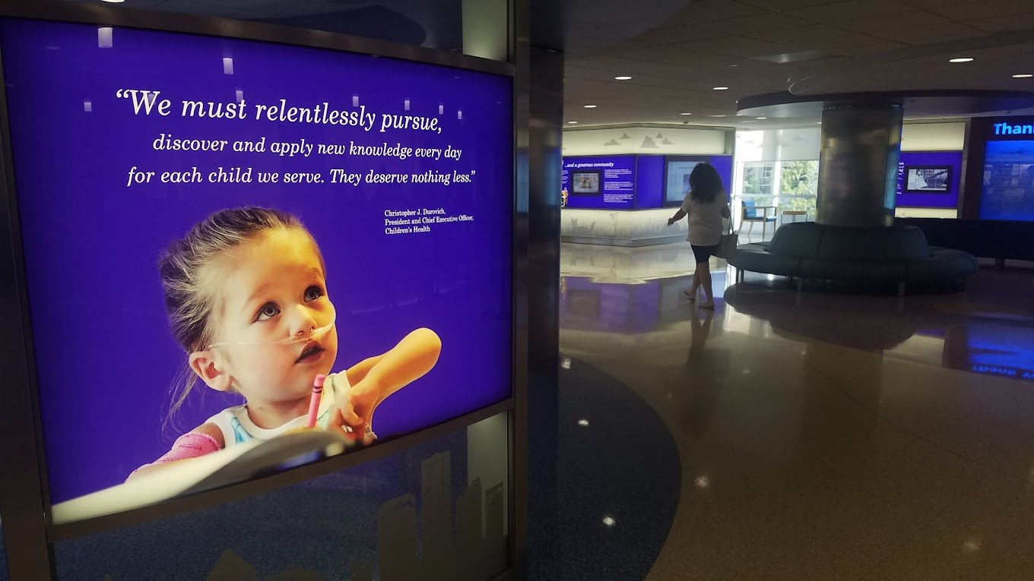
How we apply these practices at Children’s?

Slide 15
Identified potential areas for improvement
Utilization of tactics
Assessment of Efficiency
Application/Process

Slide 16
Identification of Opportunities
1st
2nd
3RD
Areas and processes that could be enhanced were identified in the field of psychiatry where we were already providing services, such as: - Day Treatment - Outpatient Psychiatry y
New opportunities in the field of psychiatry were identified for integration, which could benefit from our services, including: - Emergency Department (ED) - SPARC - Hospital Behavioral Health
Meetings were conducted with each department to provide updates and introduce educational services, as well as the support we could offer to enhance the program..
Research Based Practices

Slide 17
Application of Strategies
How we integrated research findings/strategies from the research articles into our program that would make sense.
First, we will go over the research articles we used to help guide us:
“Returning to School Following Hospitalization for Suicide-Related Behaviors: Recognizing Student Voices for Improving Practice.”
“Caregiver Experiences of Adolescent School Reentry After Adolescent Hospitalization Due to Suicidal Thoughts and Behaviors: Recommendations to Improve Reentry Practices”
“Patient’s well-being during the transition period after psychiatric hospitalization to school: insights from an intensive longitudinal assessment of patient- parent-teacher triads.”
“Framework for successful school reintegration after psychiatric hospitalization: A systematic synthesis of expert recommendations.”
Research Based Practices

Slide 18
Application of Strategies Cont.
Data gathered- Concerns:
The need for guidance in navigating social situations with both peers and adults,
Understanding available supports and services,
Academic performance,
The impact of mental health on schoolwork,
Readjusting to the school routine,
Managing psychiatric symptoms while at school,
Improving communication between families and schools regarding patient progress
Educating school staff on mental health matters.
Research Based Practices

Slide 19
Actions taken based on data gathered in Day Treatment:
Revised our transition procedures for patients returning to school
Emphasized that the transition process starts upon admission
Incorporated classroom observation time for the case manager
Scheduled transition meetings with the school early in the treatment process, with parents being informed
Enhanced the intake student questionnaire
Updated patient school transition questionnaires to include more specific questions assessing the patient's readiness and mindset for school return
Enhanced communication to ensure parents and schools are informed about the patient's progress and return date
Research Based Practices

Slide 20
Day Treatment cont.
We met with the case manager to get concerns and ideas, then met with the MD and clinical supervisor to get their concerns and ideas. Here are a few:
Making sure school services take ownership of the transition process
There is clinical backing when talking/dealing with concerned parents
Drafting of recommendation letter early in the treatment process
Then we created a step-by-step guide on the “Day Treatment Transition Process”

Slide 21
Day Treatment Transition Process (step by step)
https://acrobat.adobe.com/link/track?uri=urn:aaid:scds:US:8e870ef1-3908-4d64-8c47-079a2e88108d
Research Based Practice

Slide 22
Day Treatment Intake Student Questionnaire
https://acrobat.adobe.com/link/track?uri=urn:aaid:scds:US:c3bbd23e-ec58-49b2-b026-102739b2cbf4

Slide 23
Day Treatment Elementary School Plan
https://acrobat.adobe.com/link/track?uri=urn:aaid:scds:US:fb48f980-e59f-4a7e-8205-0dceb3ee887c
Research Based Practices

Slide 24
Day Treatment Intermediate School Plan
https://acrobat.adobe.com/link/track?uri=urn:aaid:scds:US:3569efac-5bb0-46c0-af27-70a4ae03049e
Research Based Practice

Slide 25
Day Treatment Teen Patient School Plan
https://acrobat.adobe.com/link/track?uri=urn:aaid:scds:US:1fea2455-3d3d-4653-a919-ff64e6b9e07b

Slide 26
Held meetings with each program.
Created presentations that catered to the program’s needs:
Explained what is school services
How we can support their specific departments
Added statistical and research-based information as to why the school services department is vital to have
Developed process guidelines and put them in writing for the school services staff and the clinical staff to refer to.
Once process guides were completed, ensured each department and staff member had a copy of the processes.
Emergency Department and SPARC Suicide Prevention and Resilience at Children’s
(2023/2024 Programs)
Research Based Practice

Slide 27
Emergency Department
Developed a quick assessment questionnaire to get information on family needs when we see them in the ED
Developed process guides for the designated educational specialist on how to handle consult calls if the patient has not been discharged from the ED and guide on how to handle patients if they have been discharged from the ED.
Developed a process guide for the ED on when to contact school services for support and how to contact school services for support.
Research Based Practice

Slide 28
Research Based Practice
ED School Services Program Plan
https://acrobat.adobe.com/link/track?uri=urn:aaid:scds:US:07effea8-2150-4baf-8ceb-4b34a1ccb669

Slide 29
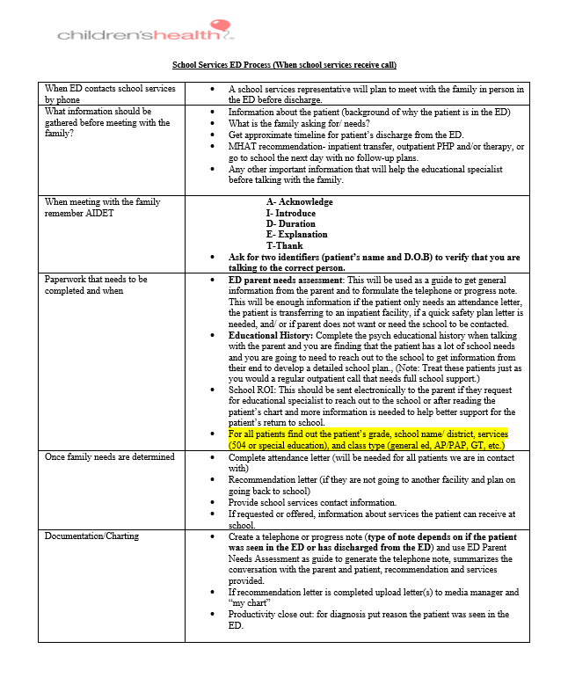
ED Process (before discharge) https://acrobat.adobe.com/link/track?uri=urn:aaid:scds:US:67e5f24a-645a-46f3-80f2-b462296f65cb

Slide 30
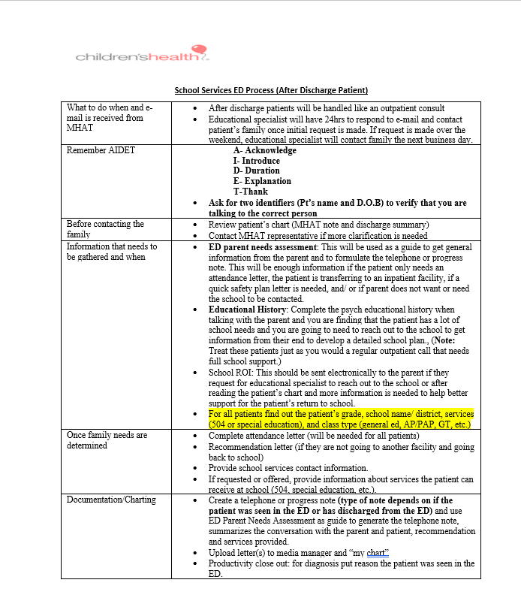
ED Process (After Discharge) https://acrobat.adobe.com/link/track?uri=urn:aaid:scds:US:1c2f8b84-45d8-423c-b1fb-b9179ab3e460

Slide 31
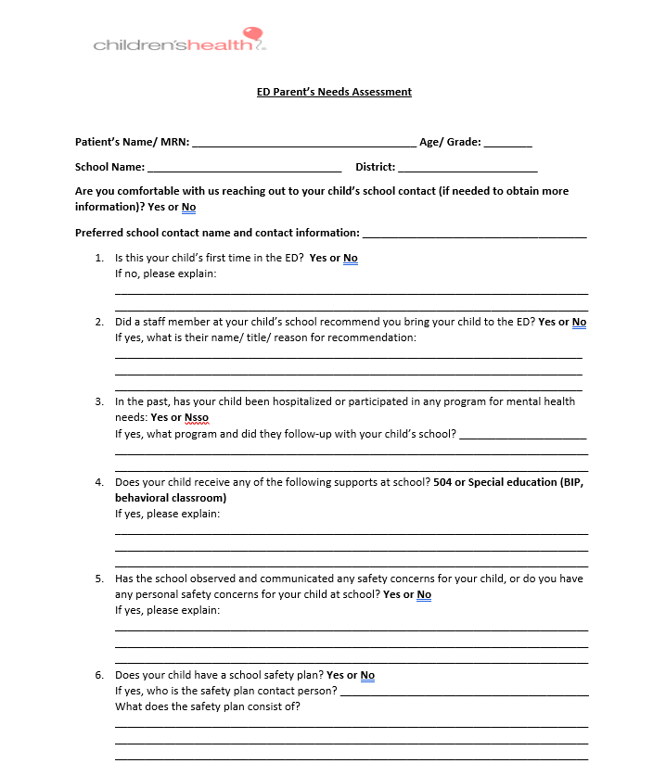
Research Based Practice
ED Needs Assessment
https://acrobat.adobe.com/link/track?uri=urn:aaid:scds:US:c858631f-5621-48d3-bd14-99681532a9ea

Slide 32
SPARC
Suicide Prevention and Resilience at Children’s
(
Conducted meetings with SPARC clinicians to gather their requirements and concerns regarding supporting patients with school-related matters.
Reviewed their procedures for managing patients with school-related issues and provided recommendations, including assessment questions and recommendation letters.
Collaborated to create a comprehensive plan/guide for school services support tailored specifically for the SPARC program.
Created an initial assessment questionnaire for therapists to determine the need for school support for the patient and family.
Provide educational specialists with background information on the patient before reaching out to the parent.
Designed a questionnaire for therapists to assess the need for school support for the patient and family, while also giving educational specialists background information before contacting the parent.
Research Based Practices

Slide 33
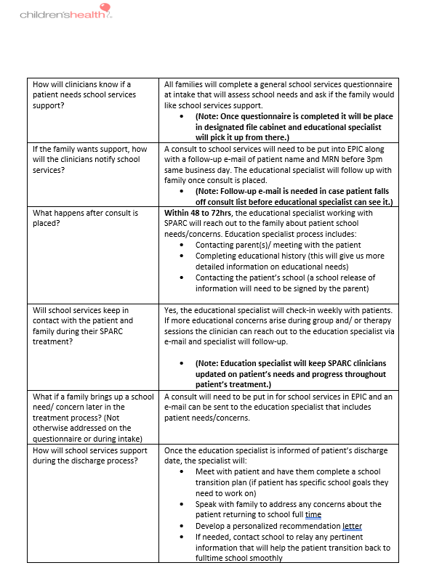
SPARC Consult Process
https://acrobat.adobe.com/link/track?uri=urn:aaid:scds:US:9356dc8c-4411-4d19-aede-729bd7a1bcfe

Slide 34
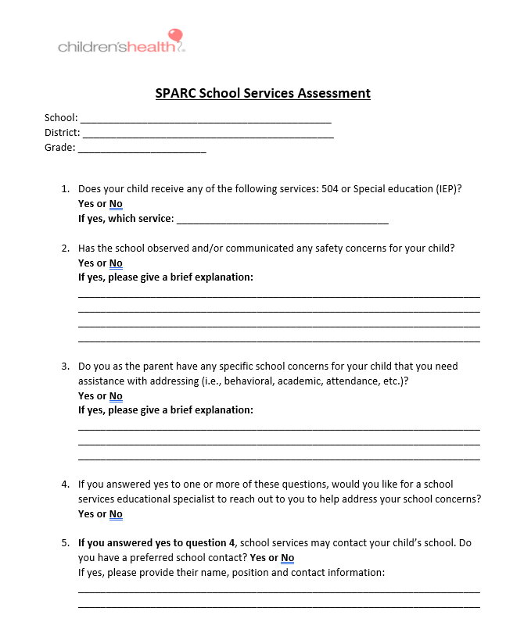
SPARC School Services Assessment
SPARC School Services Assessment (cloud.microsoft)
Research Based Practice

Slide 35
SPARC Patient Documentation Process
https://acrobat.adobe.com/link/track?uri=urn:aaid:scds:US:53b4a9b1-bc9e-4ce0-b0d7-5b8cb6f5b486

Slide 36
Evaluation of Effectiveness
Conducted quarterly rounding sessions with clinicians from different areas of psychiatry, including Day Treatment, outpatient consults, ED, SPARC, and hospital behavioral health.
Held monthly one-to-one rounding sessions with educational specialists working in various areas of psychiatry.
Evaluated the progress of our research-based approaches in the program through regular interactions and feedback sessions with clinicians and educational specialists in psychiatry.
Evaluation

Slide 38
References
Aperture Education: https://www.apertureed.com/resources/evidence-based-vs-research-based
Burrell Behavior Health “2023 Youth Mental Health Report” https://assets.burrellcenter.com/2023-Youth-Mental-Health-Report.pdf
Lohar, W.D., Jawad, K.S., Wood, N., Le, J., Stevenson, M.D., Feygin, Y., Winderd-Davis, D. (2023). Factors Associated With Child and Youth Mental Health Readmissions From a US Database www.jaacapopen.org
Marraccini, M.E., Pittleman, C. (2022) Returning to School Following Hospitalization for Suicide-Related Behaviors: Recognizing Students Voices for Improving Practices School Psych Review
“What is evidence Based Practice in Nursing”
https://online.xavier.edu/why-is-evidence-based-practice-in-nursing-important/#:~:text=Constant%20exposure%20to%20new%20research,and%20technologies%20into%20their%20practice.
References

Slide 39
References
Vanderburg, J.L., Tow, A.T., Marracinni, M.E., Pittleman, C., Cruz, C.M. (2023) Caregiver Experiences of Adolescent School Reentry After Adolescent Hospitalization Due to Suicidal Thoughts and Behaviors: Recommendations to Improve Reentry Practices Journal of School Health
Tougas, A.M., Houle, A.A., Leduc, K., Frenette-Bergeron, E., Marcil, K. (2022) Framework for successful school reintegration after psychiatric hospitalization: A synthesis of expert recommendations Psychology in Schools
Finkbeiner, M., Wahl, L.M., Kuhnhausen, J., Schmid, J., Hellwig, L., Brenner, V., Durrwachter, U., Conzelman, A., Kelva, A., Renner, T., Gawrilow, C. (2023) Patients’ well-being during the transition period after psychiatric hospitalization to school: insights from an intensive longitudinal assessment of patient-parent- teacher triads BMC Psychology
References

Slide 40
Ashley Hurse, MA
Ashley.Hurse@childrens.com
(214)534-3691
Talia Fayson-Anthony, M.Ed.
Talia.Fayson@childrens.com
(214)537-4765
Contact Information

